Slide 1
CS4102 Algorithms Spring 2021 – Floryan and Horton
Module 4, Day 3: Recorded Lecture

Slide 2
Roadmap: Where We’re Going and Why
Reductions between problems
Why? Can be a practical way of solving a new problem
Also: A proof about one problem’s complexity can be applied to another
Formal definition of a reduction
Examples
Bipartite graphs, matching
Vertex cover and independent set

Slide 3
Using One Solution to Solve Something Else
Sometimes we can solve a “new” problem using a solution to another problem
We need to “re-cast” the “new” problem as an instance of the other problem
We may need to relate how the answer found for the other problem gives the answer for the “new” problem
Some examples coming in this lecture:
We’ll see how to solve edge-disjoint path problem. Use that to solve vertex-disjoint path problem.
We know how to find max network flow. Use that to solve bi-partite matching.

Slide 4


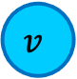
Edge-Disjoint Paths
Given a graph $G=(V,E)$, a start node $u$ and a destination node $v$, give the maximum number of paths from $u$ to $v$ which share no edges
g
Note this is an optimization problem.
$$u$$
h
f
$$v$$
e
b
c
a

Slide 5
Edge-Disjoint Paths
Given a graph $G=(V,E)$, a start node $u$ and a destination node $v$, give the maximum number of paths from $u$ to $v$ which share no edges
Set of edge-disjoint paths of size 3
(the red, blue, magenta paths)
$$u$$
g
Is this the max number?
h
f
$$v$$
e
b
c
a

Slide 6


Edge-Disjoint Paths
Given a graph $G=(V,E)$, a start node $u$ and a destination node $v$, give the maximum number of paths from $u$ to $v$ which share no edges
g
Set of edge-disjoint paths of size 4
$$u$$
Is this the max number?
h
f
$$v$$
e
b
c
a

Slide 7



Edge-Disjoint Paths Algorithm
Use a problem we know how to solve, max network flow, to solve this!
Make $u$ and $v$ the source and sink, give each edge capacity $1$, find the max flow.
1/1
$$s$$
g
Set of edge-disjoint paths of size 4
1/1
0/1
1/1
Max flow = 4
h
1/1
1/1
1/1
f
1/1
0/1
Why does this work? We need to be able to make a valid argument that it always does.
1/1
$$t$$
e
b
0/1
1/1
1/1
c
0/1
a
0/1

Slide 8
What’s the situation?
Given an input I₁ for the max network flow problem (graph G with edge capacities), we can find the max flow for that input
Given an input I₂ for edge-disjoint path problem, we can:
Convert that input I₂ to make a valid input I₁ for network flow problem, by using same graph G but adding capacity=1 for each edge
Solve max network flow problem for I₁ and get result R₁
Use R₁ to give the solution R₂ for edge-disjoint path for input I₂
In this case, |f| = the number of paths
Next, let’s solve another problem using our new edge-disjoint path solution

Slide 9
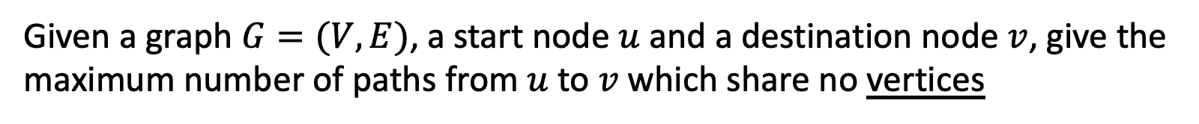
Vertex-Disjoint Paths
Given a graph $G=(V,E)$, a start node $u$ and a destination node $v$, give the maximum number of paths from $u$ to $v$ which share no vertices
$$u$$
g
h
f
$$v$$
e
b
c
a

Slide 10
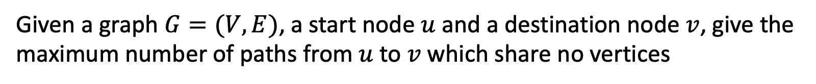
Vertex-Disjoint Paths
Given a graph $G=(V,E)$, a start node $u$ and a destination node $v$, give the maximum number of paths from $u$ to $v$ which share no vertices
This shows 3 edge-disjoint paths. Note these aren’t vertex-disjoint paths!
$$u$$
g
h
f
$$v$$
e
b
c
a

Slide 11


Vertex-Disjoint Paths Algorithm
Idea: Convert an instance of the vertex-disjoint paths problem into an instance of edge-disjoint paths
Make two copies of each node, one connected to incoming edges, the other to outgoing edges
Compute Edge-Disjoint Paths on new graph
$$u$$
g
Restricts to 1 edge
g in
g out
h
f
Why does this work? We need to be able to make a valid argument that it always does.
$$v$$
e
b
c
a

Slide 12
What’s the situation now?
Given an input I₁ for the max network flow problem (graph G with edge capacities), we can find max flow for that input
Given an input I₂ for edge-disjoint path problem, we can:
Convert that input I₂ to make a valid input I₁ for network flow problem, and solve that to find number of edge-disjoint paths
Given an input I₃ for vertex-disjoint path problem, we can:
Convert that input I₃ to make a valid input I₂ for edge-disjoint path problem
See above! Convert I₂ to I₁ and solve max network flow problem
This chain of “problem conversions” finds lets us solve vertex-disjoint path problem
Time complexity? Cost of solving max network flow plus two conversions

Slide 13
Reductions
(We’re about to get interested in problems that seem to require exponential time…)

Slide 14
Max-flow vs. min-cut
These two problems are “equivalent”
Remember? max-flow min-cut theorem
Here we’re saying: if you can solve one, you can solve the other
Alternatively, we can say that one problem reduces to the other
The problem of finding min-cut reduces to the problem of finding max-flow
Maybe this reduction requires some work to “convert”
Could be nothing or minimal
For these problems, the cost of the conversion is polynomial

Slide 15
Reduction
A reduction is a transformation of one problem into another problem
Min-cut is reducible to max-flow because we can use max-flow to solve min-cut
Formally, problem A is reducible to problem B if we can use a solution to B to solve A
We’re particularly interested in reductions that happen in polynomial time
If A is polynomial-time reducible to B, we denote this as: A ≤_{p} B

Slide 16
Reducing both ways
It’s easy to see that:
Min-cut ≤_{p} max-flow
Max-flow ≤_{p} min-cut
Because they reduce both ways, they are polynomial-time equivalent
If we find a polynomial solution for one, the other is also polynomial
What if we prove an exponential lower-bound for one? Is it possible that the other one could have a polynomial solution?

Slide 17
Bipartite Matching

Slide 18
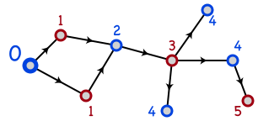
Bipartite Graphs
A graph is bipartite if node-set V can be split into sets X and Y such that every edge has one end in X and one end in Y
X and Y could be colored red and blue
Or Boolean true/false
How to determine if G is bipartite?
The numbers and arrows on edges may give you a clue….
BFS or DFS, and label nodes by levels in tree. Non-tree edge to node with same label means NOT bipartite.

Slide 19
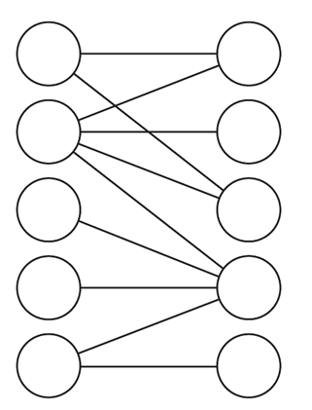
Notes and assumptions
We assume the graph is connected
Otherwise we will only look at each connected component individually
A triangle cannot be bipartite
In fact, any graph with an odd length cycle cannot be bipartite

Slide 20

Maximum Bipartite Matching
Dog Lovers
Adoptable Dogs

Slide 21
Maximum Bipartite Matching
Dog Lovers
Adoptable Dogs
Is this the best possible? The largest possible set of edges?

Slide 22
Maximum Bipartite Matching
Dog Lovers
Adoptable Dogs
Better! In fact, the maximum possible! How can we tell?
A perfect bipartite match:
Equal-sized left and right subsets, and all nodes have a matching edge

Slide 23
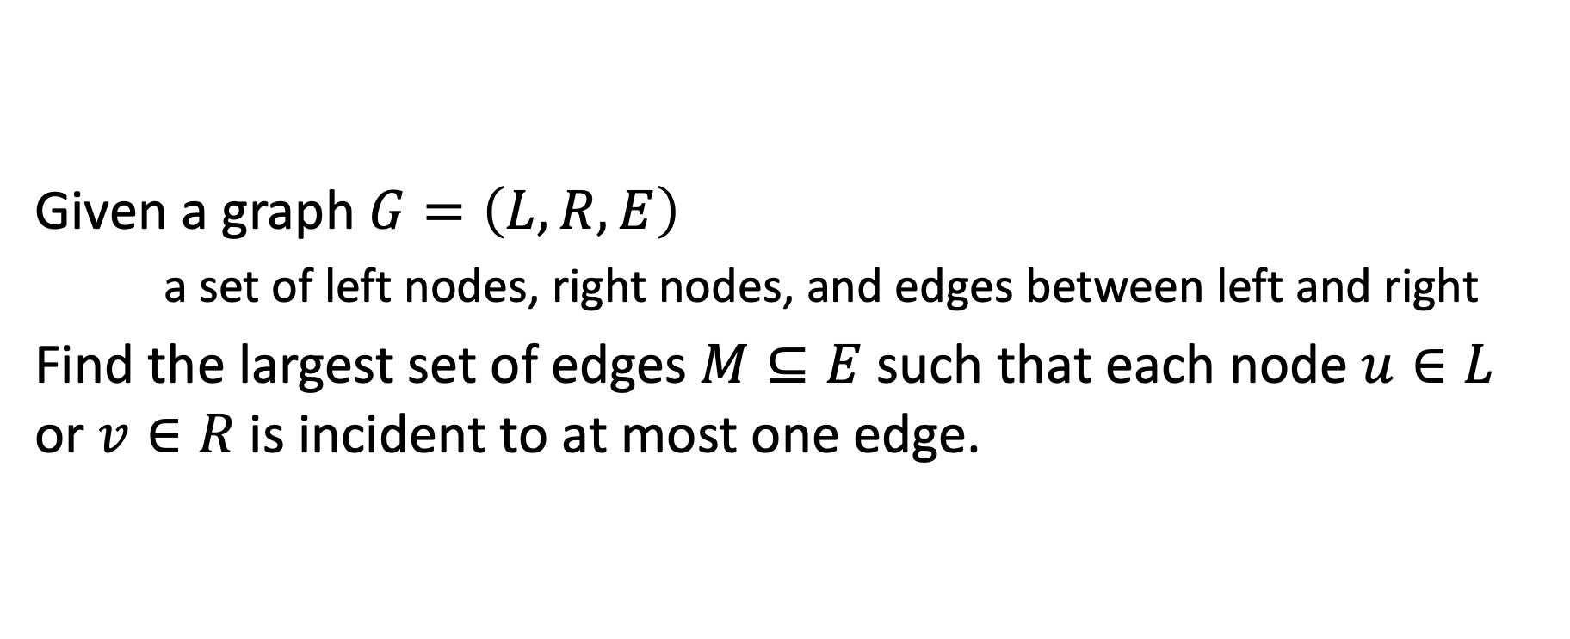
Maximum Bipartite Matching
Given a graph $G=\left(L,R,E\right)$
a set of left nodes, right nodes, and edges between left and right
Find the largest set of edges $M⊆E$ such that each node $u∈L$ or $v∈R$ is incident to at most one edge.

Slide 24
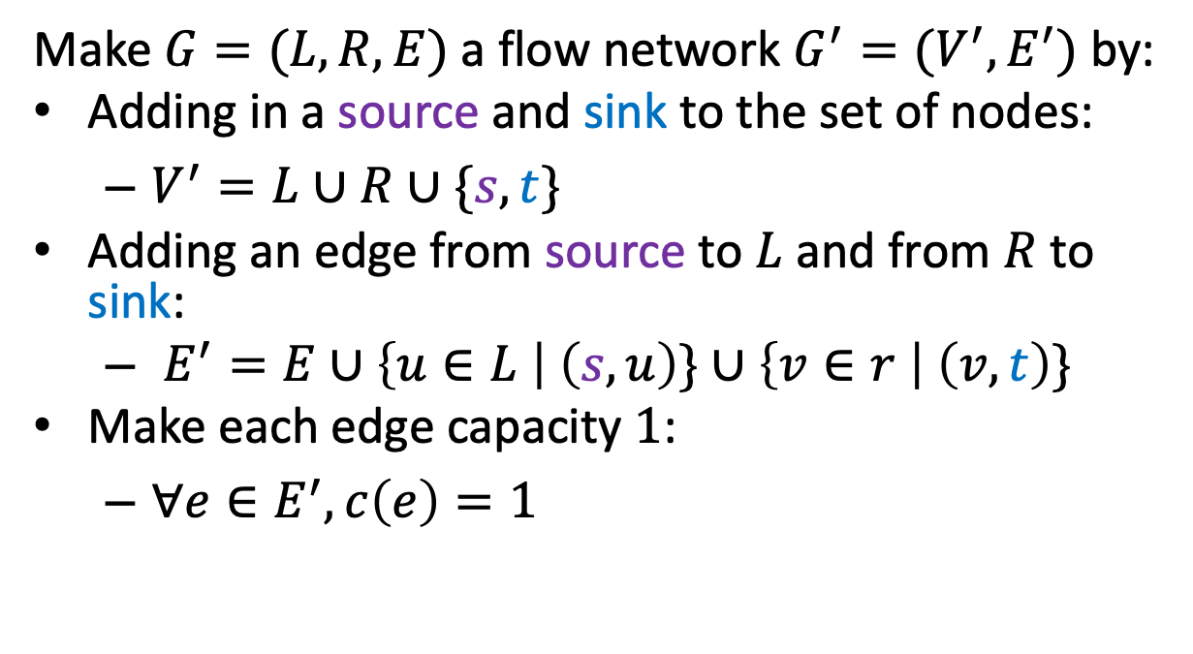


Maximum Bipartite Matching Using Max Flow
Make $G=(L,R,E)$ a flow network $G^{′}=(V^{′},E^{′})$ by:
Adding in a source and sink to the set of nodes:
$V^{′}=L∪R∪\{s,t\}$
Adding an edge from source to $L$ and from $R$ to sink:
$E^{′}=E∪\left\{u∈L \right| \left(s,u\right)\}∪\left\{v∈r \right| \left(v,t\right)\}$
Make each edge capacity $1$:
$∀e∈E^{′}, c\left(e\right)=1$
1
1
1
1
1
1
$$s$$
1
1
1
1
$$t$$
1
1
1
1
1
1
1

Slide 25

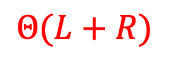
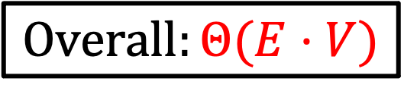
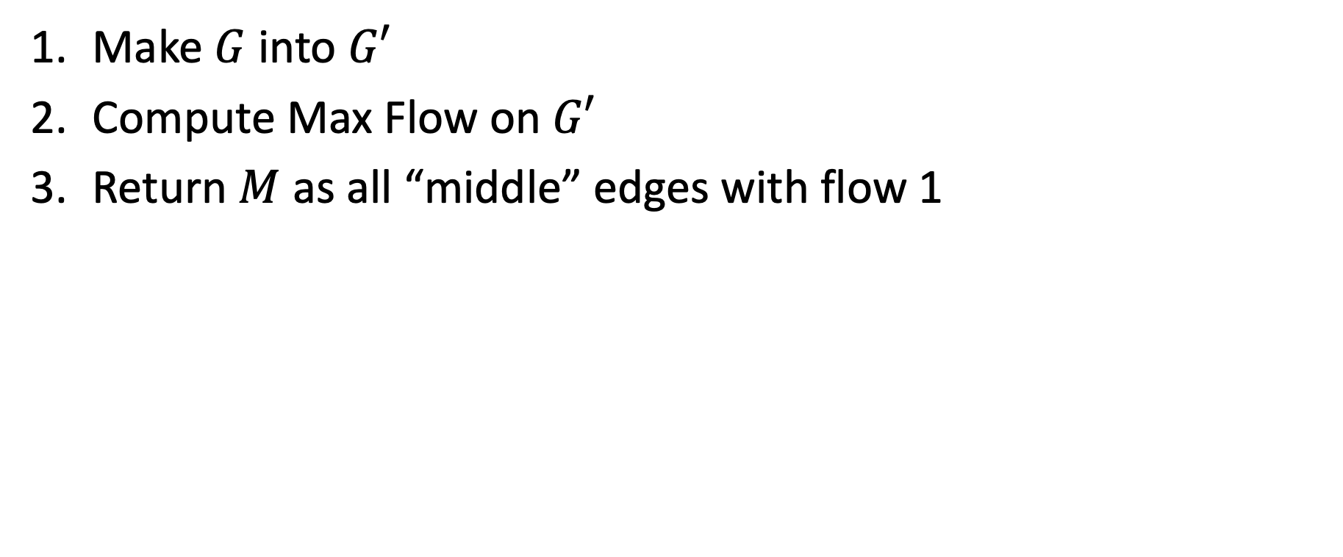
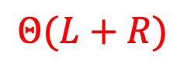
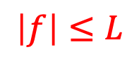
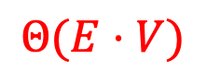

Maximum Bipartite Matching Using Max Flow
Make $G$ into $G′$
Compute Max Flow on $G′$
Return $M$ as all “middle” edges with flow 1
$$Θ(L+R)$$
$$Θ(E⋅V)$$
$$\left|f\right|≤L$$
$$Θ(L+R)$$
0/1
$$Overall:Θ(E⋅V)$$
1/1
0/1
1/1
1/1
1/1
$$s$$
1/1
0/1
1/1
0/1
$$t$$
1/1
1/1
1/1
1/1
1/1
1/1
0/1

Slide 26
Roadmap: Where We’ve Been and Why
Reductions between problems
Why? Can be a practical way of solving a new problem
Coming soon: A proof about one problem’s complexity can be applied to another
Formal definition of a reduction
Examples
Bipartite graphs, matching
Next: example problems: vertex cover and independent set
Then, classes of problems: P, NP, NP-Hard, NP-complete

Slide 27
CS4102 Algorithms Spring 2021 – Floryan and Horton
Module 4, Day 3: Live Session, April 26

Slide 28
Roadmap: Where We’ve Been and Why
Reductions between problems
Why? Can be a practical way of solving a new problem
Coming soon: A proof about one problem’s complexity can be applied to another
Formal definition of a reduction
Examples
Bipartite matching and max network flow
Today: example problems: vertex cover and independent set
Next Lecture: classes of problems: P, NP, NP-Hard, NP-complete

Slide 29
Today: Two graph problems that are similar: minimum vertex cover and maximum independent set
We’ll do a formal proof that these are polynomial-time equivalent
Each reduces to the other
BTW, vertex cover is needed for Basic Written HW, Question 2

Slide 30
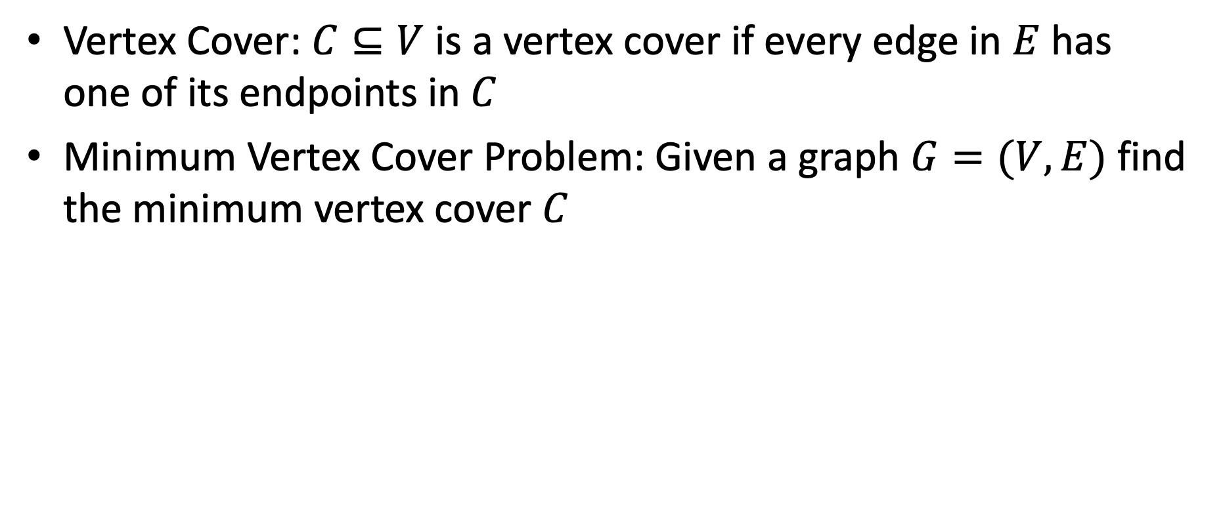
Minimum Vertex Cover
Vertex Cover: $C⊆V$ is a vertex cover if every edge in $E$ has one of its endpoints in $C$
Minimum Vertex Cover Problem: Given a graph $G=(V,E)$ find the minimum vertex cover $C$
Vertex cover of size 6
Vertex cover of size 5
Is 5 the smallest? Is there one with 4?

Slide 31
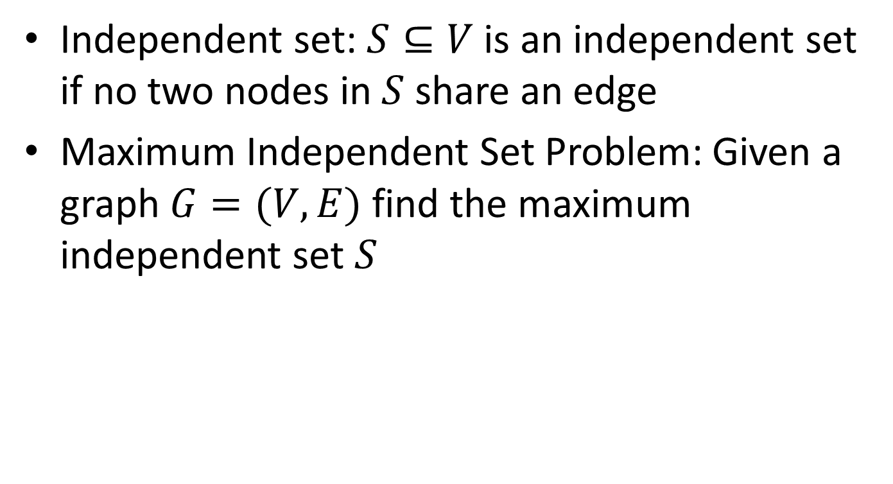
Maximum Independent Set
Independent set: $S⊆V$ is an independent set if no two nodes in $S$ share an edge
Maximum Independent Set Problem: Given a graph $G=(V,E)$ find the maximum independent set $S$

Slide 32
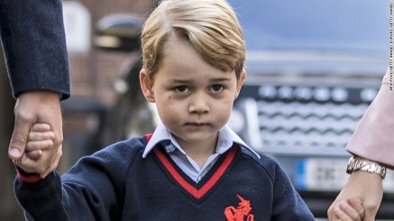



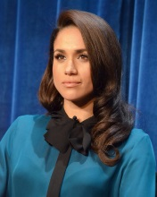
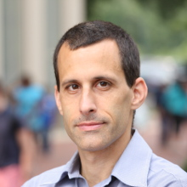




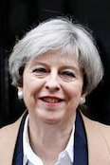
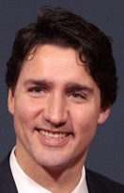
Party Problem
Draw edges between people who don’t get along.
Find the maximum number of people who DO get along.

Slide 33
Example
Independent set of size 6

Slide 34


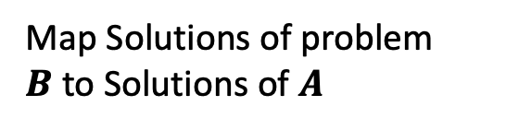
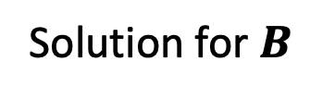
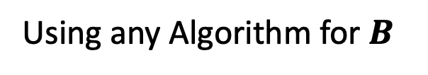




In General: A Reduction
A problem we don’t know how to solve
Reduction
A problem we do know how to solve
$$A$$
Map Instances of problem $A$to Instances of $B$
$$B$$
Using any Algorithm for $B$
Map Solutions of problem $B$to Solutions of $A$
Solution for $A$
Solution for $B$
$$RA$$
$$RB$$

Slide 35
In General: Reduction
Problem we don’t know how to solve
Reduction
Problem we do know how to solve
$$A$$
Map Instances of problem $A$to Instances of $B$
$$B$$
Using any Algorithm for $B$
Map Solutions of problem $B$to Solutions of $A$
For now: we are NOT focusing on an algorithm to solve one of these, just on the reduction!
Solution for $A$
Solution for $B$
$$RA$$
$$RB$$

Slide 36
Polynomial-Time Equivalence
We’ll show a reduction in both directions:
MinVertCov ≤_{p} MaxIndSet
MaxIndSet ≤_{p} MinVertCov
Because they reduce both ways, they are polynomial-time equivalent
(We’ll justify the following claims later.)
If we find a polynomial solution for one, the other is also polynomial
What if we prove an exponential lower-bound for one? Is it possible that the other one could have a polynomial solution?

Slide 37









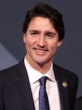
Reduction Idea
$S$ is an independent set of $G$ iff $V−S$ is a vertex cover of $G$
Independent Set
Vertex Cover

Slide 38
Reduction Idea
$S$ is an independent set of $G$ iff $V−S$ is a vertex cover of $G$
Vertex Cover
Independent Set

Slide 39


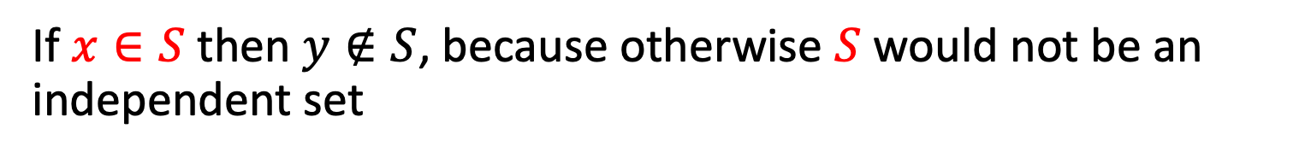
Proof: $⇒$
$S$ is an independent set of $G$ iff $V−S$ is a vertex cover of $G$
Let $S$ be an independent set
Consider any edge $\left(x,y\right)∈E$
If $x∈S$ then $y∉S$, because otherwise $S$ would not be an independent set
Therefore $y∈V−S$, so edge $(x,y)$ is covered by $V−S$

Slide 40
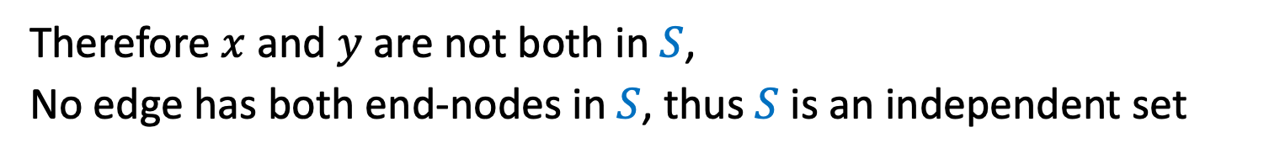

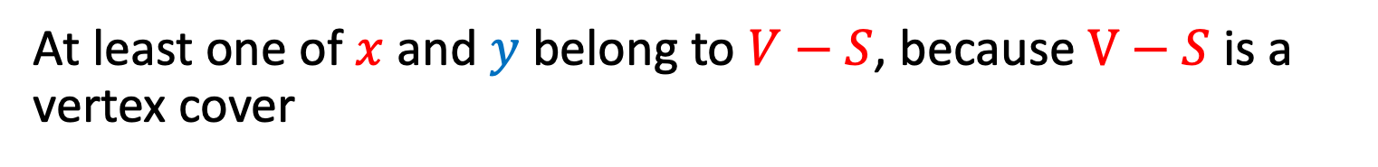
Proof: $⇐$
$S$ is an independent set of $G$ iff $V−S$ is a vertex cover of $G$
Let $V−S$ be a vertex cover
Consider any edge $\left(x,y\right)∈E$
At least one of $x$ and $y$ belong to $V−S$, because $V−S$ is a vertex cover
Therefore $x$ and $y$ are not both in $S$,
No edge has both end-nodes in $S$, thus $S$ is an independent set

Slide 41

























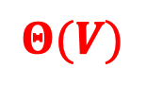

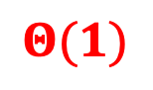
The Reduction: MaxIndSet $≤_{P}$ MinVertCov
MaxIndSet
Reduction
MinVertCov
$$A$$
Do nothing.
$$B$$
$$Θ(1)$$
Algorithm for MinVertCov
Take complement of solution.
Solution for MaxIndSet
$$Θ(V)$$
Solution for $\text{MinVertCov}$
$$RA$$
$$RB$$

Slide 42
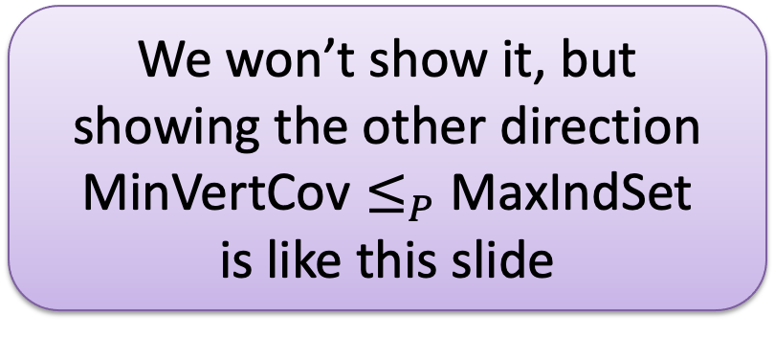

MaxIndSet $≤_{P}$ MinVertCov
MaxIndSet
Reduction
MinVertCov
We won’t show it, but showing the other direction $\text{MinVertCov}≤_{P}$ MaxIndSet is like this slide
$$A$$
Do nothing
$$B$$
$$Θ(1)$$
Yes, it’s kind of trivial, but we just proved it’s a valid reduction. And it’s polynomial.
Algorithm for MinVertCov
Take complement of solution
Solution for MaxIndSet
$$Θ(V)$$
Solution for $\text{MinVertCov}$
$$RA$$
$$RB$$

Slide 43




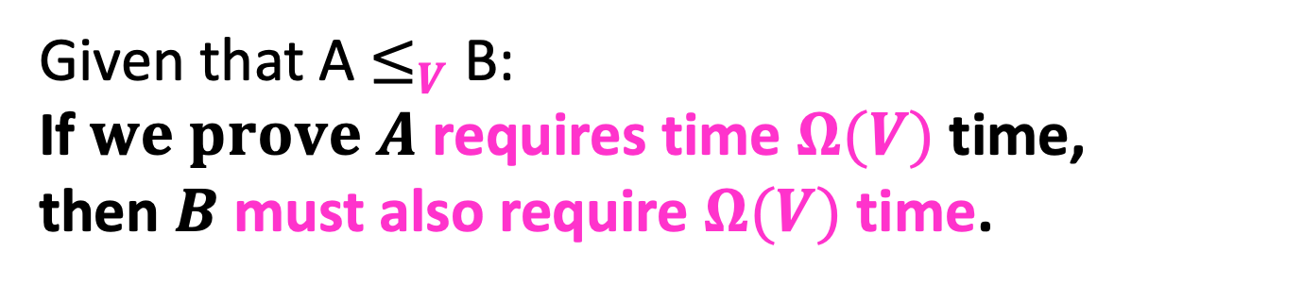
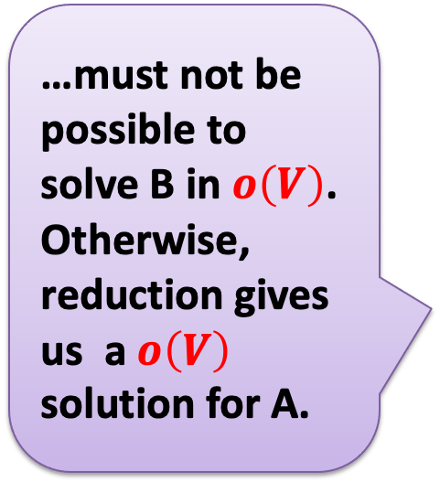

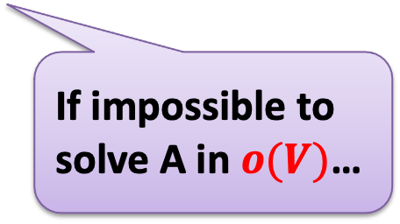
MaxIndSet $≤_{V}$ MinVertCov
…must not be possible to solve B in $o\left(V\right)$. Otherwise, reduction gives us a$o\left(V\right)$ solution for A.
$$A$$
$$B$$
Reduces to, in $Θ(V)$
Problem A
Problem B
can be used to make
Algorithm for B
Algorithm for A
With $Θ\left(V\right)$overhead
If impossible to solve A in $o(V)$…
Given that A $≤_{V}$ B:
If $we prove A$ requires time $Ω(V)$ time, then $B$ must also require $Ω(V)$ time.

Slide 44

MaxIndSet $≤_{P}$ MinVertCov
For two problems A and B, if we show A ≤_{p} B then:
If we prove A is exponential, then B must be exponential.
Otherwise, the polynomial reduction from A to B gives us a polynomial solution to A.
If we find a polynomial algorithm to B, then A is polynomial.
Use the reduction: Convert input for A to input for B, solve B in polynomial time, and you have solution for A (in polynomial time)
Therefore:
MaxIndSet and MinVertCov are either both polynomial, or both exponential

Slide 45
MaxIndSet $≤_{P}$ MinVertCov
MaxIndSet and MinVertCov are either both polynomial, or both exponential
Which is true?
Spoiler alert: We don’t know which is true! (But we think they’re both exponential.)
Both problems are NP-Complete (We’ll explain what that means soon!)

Slide 46
MaxIndSet $≤_{P}$ MinVertCov
MaxIndSet
Reduction
MinVertCov
$$A$$
Do nothing
$$B$$
$$Θ(1)$$
How about we just find a polynomial solution for MinVertCov? ☺
Algorithm for MinVertCov
Take complement of solution
Solution for MaxIndSet
$$Θ(V)$$
Solution for $\text{MinVertCov}$
$$RA$$
$$RB$$

Slide 47
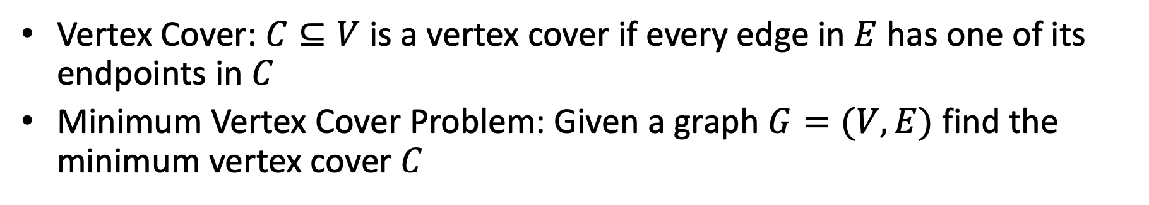
Minimum Vertex Cover
Vertex Cover: $C⊆V$ is a vertex cover if every edge in $E$ has one of its endpoints in $C$
Minimum Vertex Cover Problem: Given a graph $G=(V,E)$ find the minimum vertex cover $C$
Guess what? We can find counterexamples for each of these to show they don’t always work.
Strategy?
How about greedy?
Input Graph
Greedy choice?
(1) Pick remaining vertex of max degree. Remove its incident edges. (2) CLRS 35.1. Pick any edge (u,v). Add both to result. Remove all incident edges for u and v.

Slide 48
Wrapping Up
No one has found a polynomial algorithm for MinVertCov
Summary of what we’ve done
Two new problems: MinVertCov and MaxIndSet
Proved a reduction between them
Examined the consequences of polynomial-time equivalence for two problems with regard to whether they’re polynomial or exponential

